Slide 1

KWAME NKRUMAH UNIVERSITY OF SCIENCE AND TECHNOLOGY, KUMASI COLLEGE OF ENGINEERING CENG 291 ENGINEERING IN SOCIETY
TITLE: MINIMIZING THE NOISE FROM A SMALL-SCALE BOTTLING
COMPANY IN DOTE-KUMASI
BY: ANTWI DENNIS OWUSU
6040116
MATERIALS ENGINEERING

Slide 2
OUTLINE
A map of the community.
Nature of the problem.
Proposed solution.

Slide 3
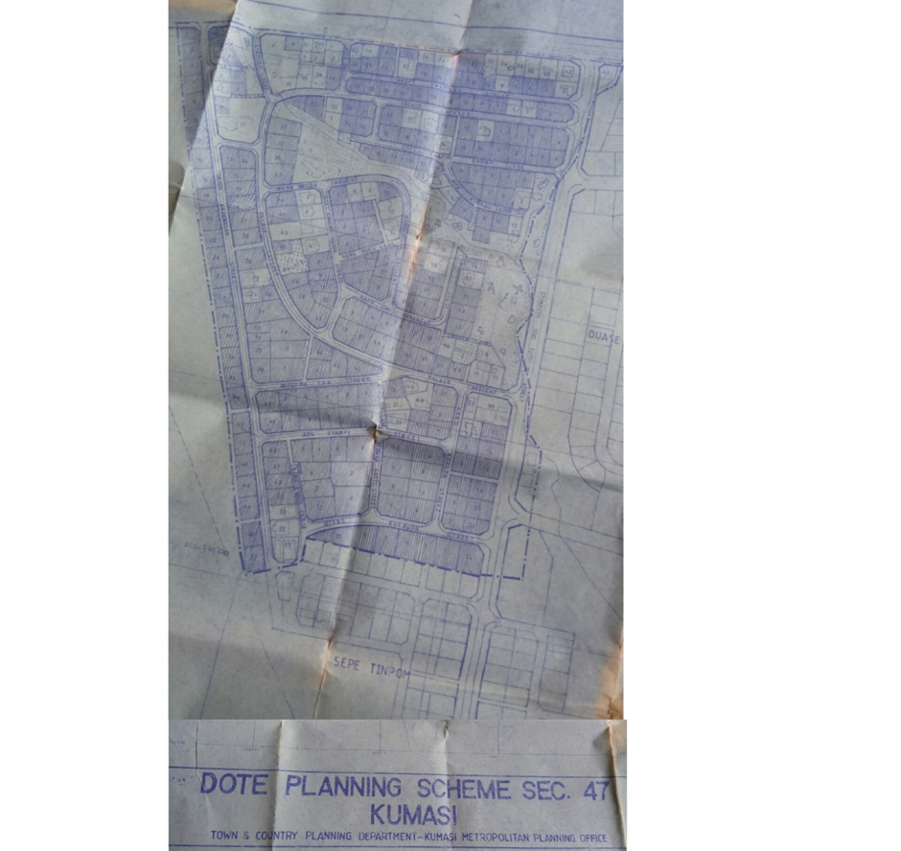
A MAP OF THE COMMUNITY

Slide 4
NATURE OF PROBLEM
CAUSE
PET BOTTLE BLOWING MACHINE
This leads to:
Rifts
Notes:
Polyethylene terephthalate is a thermoplastic polymer resin of the polyester family. Used for packaging because it is strong and light

Slide 5
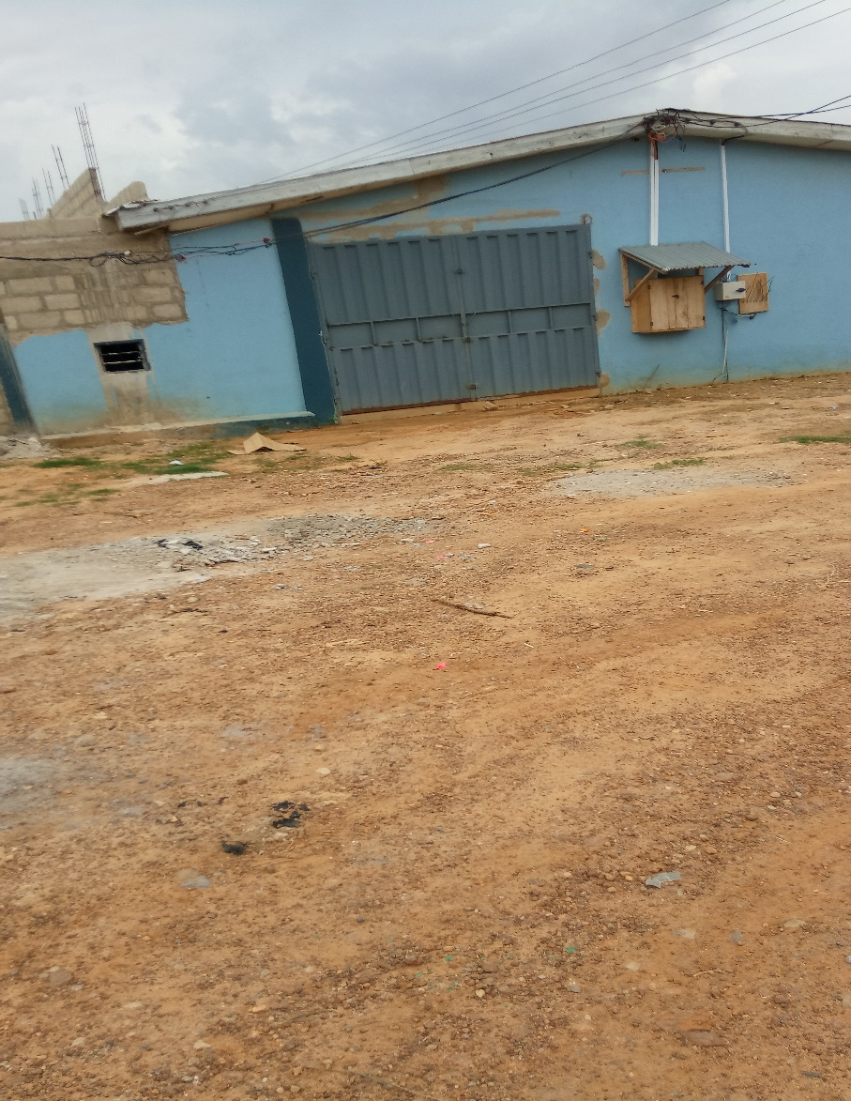
NATURE OF THE PROBLEM

Slide 6
PROPOSED SOLUTION
Cladding material used should be :
Acoustic material
From natural source

Slide 7

Bamboo plywood cladding

Slide 8
CONCLUSION
The proposed solution will be of benefit in these ways:
Serenity
Increased productivity
Notes:
It should be clearly stated that the noise from the factory is giving residents discomfort.

Slide 9
THANK YOU

